Slide 1


Climate Ready Places
Creating strong and healthy places to live, work and play
Introducing changes in the weather

Slide 2


Slide 8


Slide 9
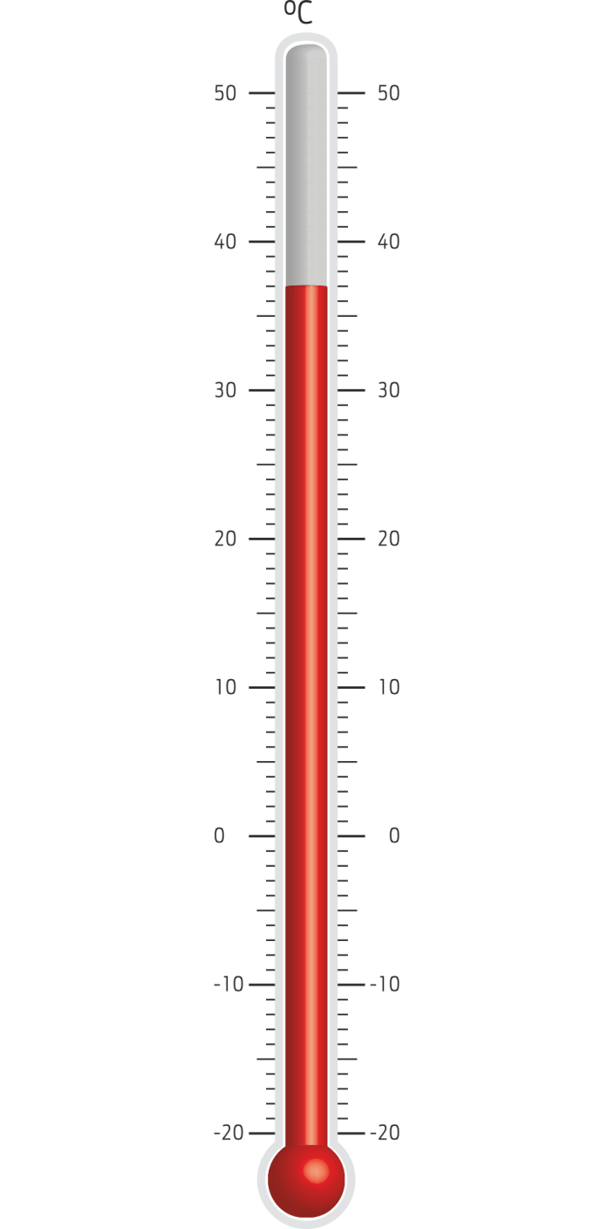

Slide 10
adaptationscotland@sniffer.org.uk
@adaptationscotland
www.adaptationscotland.org.uk
© Crown Copyright 2016. Contains public sector information licensed under the Open Government Licence v3.0. http://www.gov.scot/CrownCopyright Scottish Charity No SC022375, Company No SC149513. Registered in Edinburgh. Registered Office: 1 Exchange Crescent, Conference Square, Edinburgh, EH3 8UL

